Slide 1


Numerical Modelling of Steel Fibre Reinforced Concrete Tunnel lining Segment Subjected to Flexure
Manas Bhadury, Dr. Keerthana Kirupakaran and Dr. Ravindra Gettu
Building Technology, Construction Materials and Management (BTCM) group
Department of Civil Engineering
Indian Institute of Technology Madras, Chennai, India

Slide 2
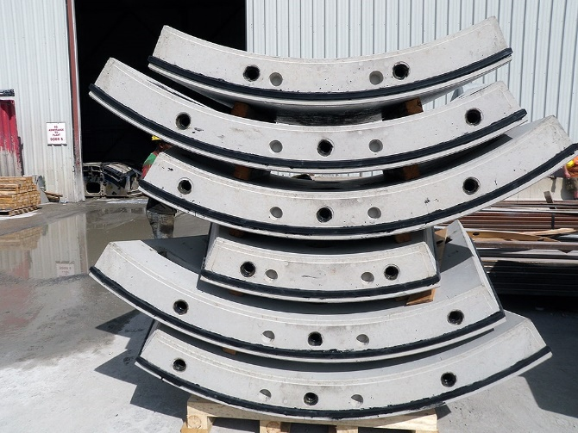
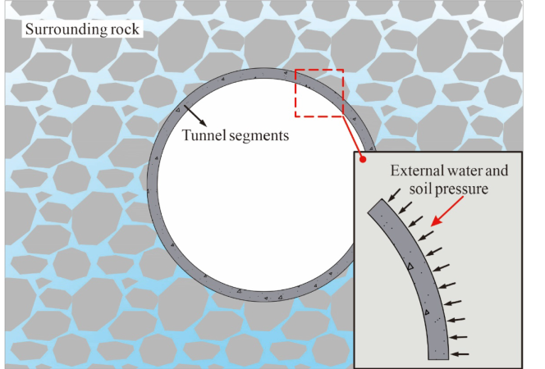
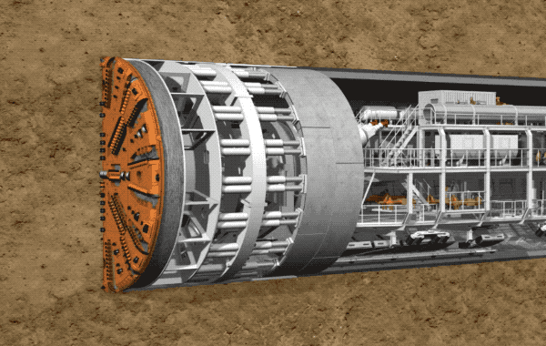
Background
Background
Methodology
Numerical modelling
Conclusions
Transient stage: stacking, handling, transportation
Bending stresses
Service stage: Soil, rock, water pressure
Construction stage: TBM jack thrust forces
Splitting and spalling stresses
Increase in bending moment and axial forces
Zhou et al. (2024) Stephen et al. (2019)

Slide 3
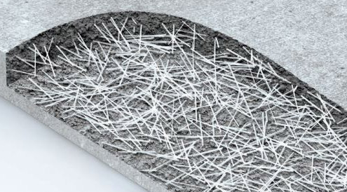
Background
Methodology
Numerical modelling
Conclusions
Background
Addition of fibres to have better crack control
Fibres
Experimental investigation: Performing large scale
experiment is difficult.
Aim: To predict the flexural capacity of tunnel segment using a robust numerical framework and validate the model with full scale experimental results.
Numerical modelling: Alternative to the large-scale experiment.
Difficulties:
Complex material model
Nonlinear analysis

Slide 4
Modelling- Methodology
Background
Methodology
Numerical modelling
Conclusions
Key elements:
Inverse analysis
How to get the tensile constitutive law?
Constitutive law
How to decide on the element size of the tunnel segment model?
2D Tunnel model
Which type of nonlinear analysis is better to give stable post peak results?
Nonlinear analysis
How do we incorporate the loading rate effect in our finite element model?
Cracking pattern, load-deflection curves

Slide 5
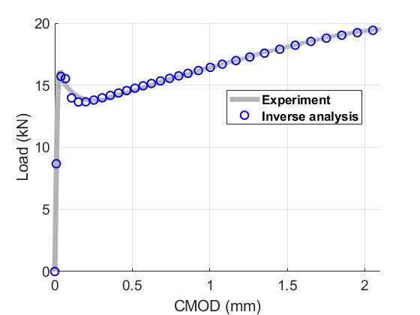
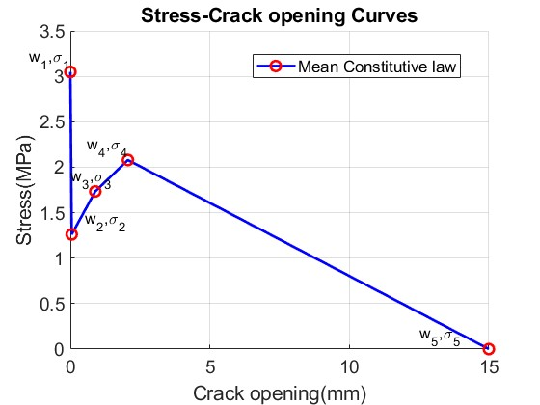
Modelling- Material parameters
Background
Methodology
Numerical modelling
Conclusions
Constitutive law:
In tension
Performing uniaxial tension test is difficult
Inverse analysis
In compression
Experiment
Inverse analysis:
Parameters | Optimized values
w₁, 𝜎₁ | 0, 3.048
w₂, 𝜎₂ | 0.047, 1.260
w₃, 𝜎₃ | 0.892, 1.733
w₄, 𝜎₄ | 2.062, 2.079
w₅, 𝜎₅ | 15, 0
Closed form solution
Olesen et al. (2001), Stephen et al. (2019), Raphael et al. (2003)

Slide 6
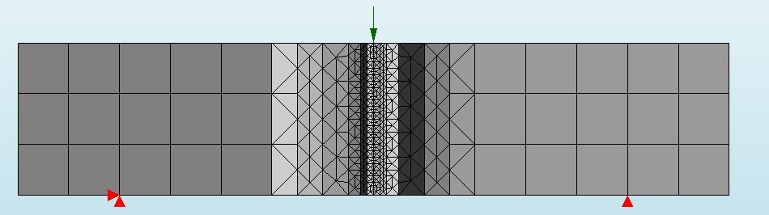
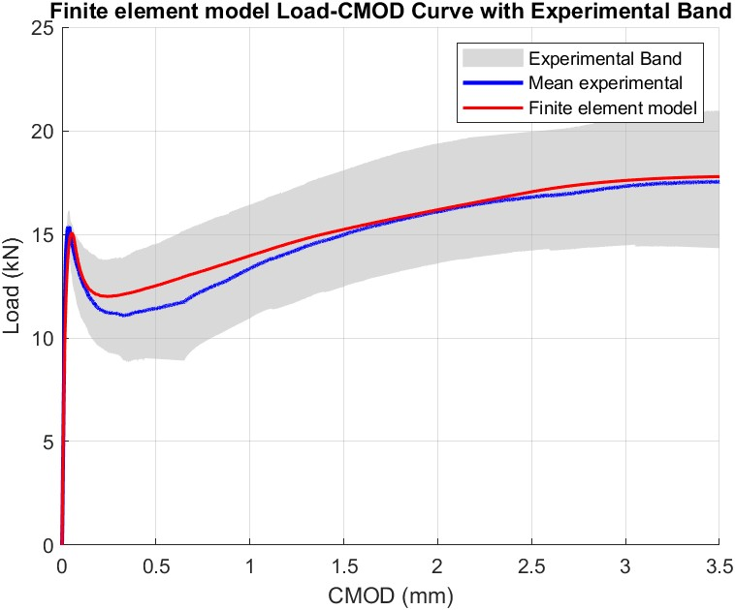
Modelling – Inverse analysis
Background
Methodology
Numerical modelling
Conclusions
Parameters | Optimized values
w₁, 𝜎₁ | 0, 3.048
w₂, 𝜎₂ | 0.047, 1.260
w₃, 𝜎₃ | 0.892, 1.733
w₄, 𝜎₄ | 2.062, 2.079
w₅, 𝜎₅ | 15, 0
Assumptions:
48 number of interface elements.
To avoid oscillatory traction profile
3-point newton-cotes integration scheme for interface elements
Normal and shear stiffness of the interface elements = 10⁸ N/mm
Schellekens et al. (1993)

Slide 7
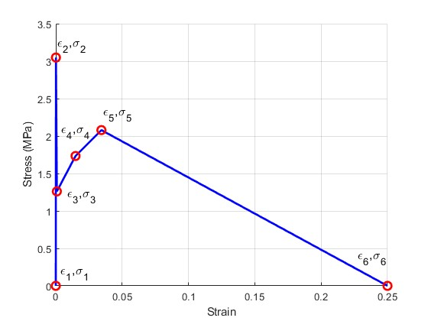
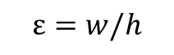
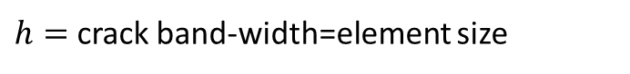
Modelling – Tunnel segment
Background
Methodology
Numerical modelling
Conclusions
Tunnel segment modelling
Crack location not known apriori
Smeared crack model
Fixed
Total strain crack model
Crack direction will depend on the direction of principal strain
$$ε=w/h$$
Rotating
$h=$ crack band-width=element size
Bazant et al. (1983), DiANA FEA manual

Slide 8
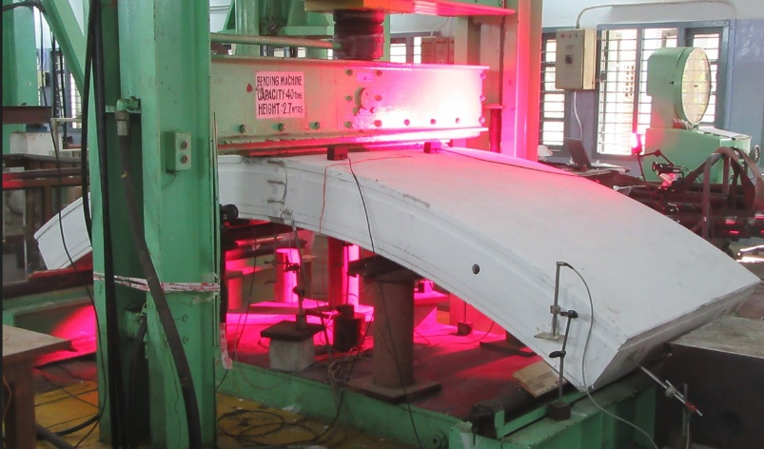
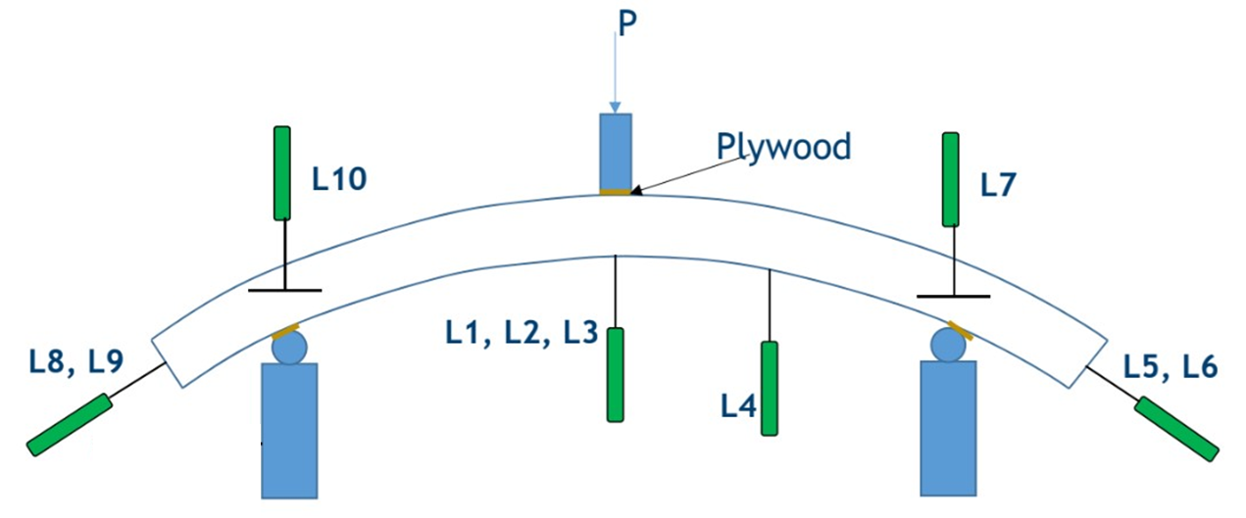
Tunnel segment – experimental details
Background
Methodology
Numerical modelling
Conclusions
L1,L2,L3 – Mid-span deflection
L4 – Quarter-span deflection
L7, L10 – Support deflection
L5, L6, L8, L9 – Specimen sliding

Slide 9
Tunnel model – flow chart
Background
Methodology
Numerical modelling
Conclusions
Loading and boundary condition
Model geometry
Material properties
Nonlinear analysis
Results
Mesh
Load-deflection curves and contour plots
Through mesh sensitivity analysis
Load-controlled and displacement- controlled analyses are compared

Slide 10
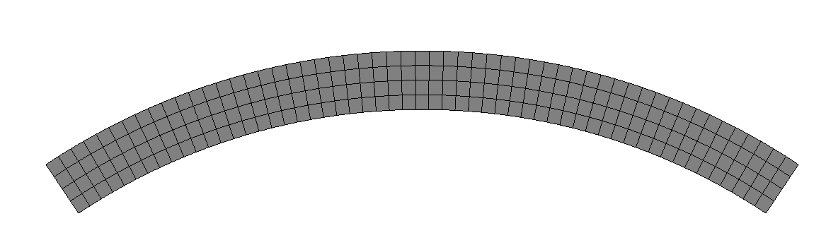
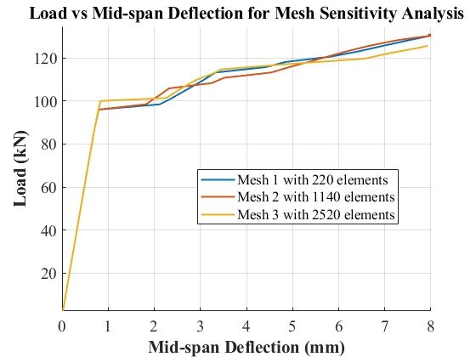
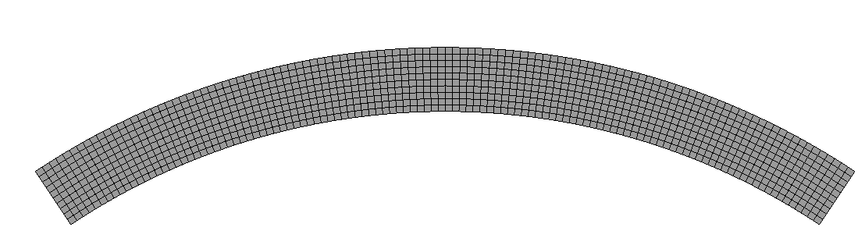
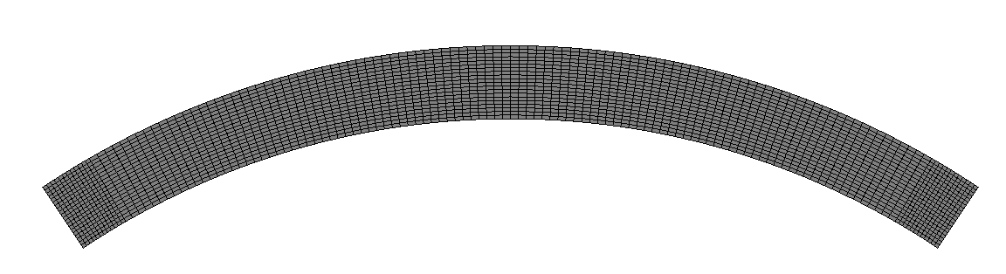
Modelling – Tunnel segment
Background
Methodology
Numerical modelling
Conclusions
Mesh sensitivity analysis
Mesh1:220 elements
8 noded quadratic plane stress elements
Mesh2: 1140 elements
In this study, 60 mm (Mesh1) mesh size is chosen which is equal to the length of steel fibre
Mesh3: 2520 elements

Slide 11
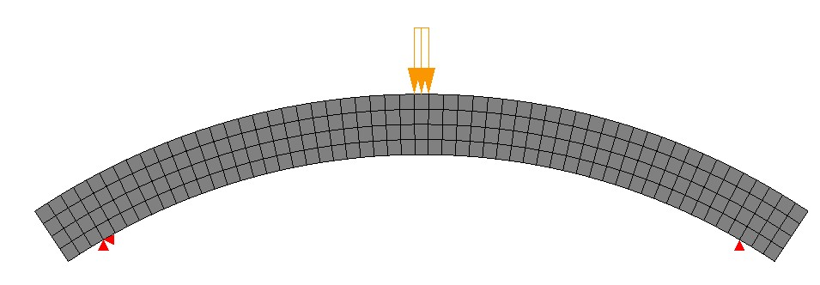
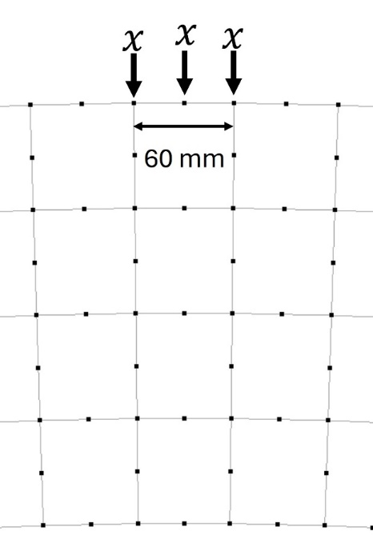
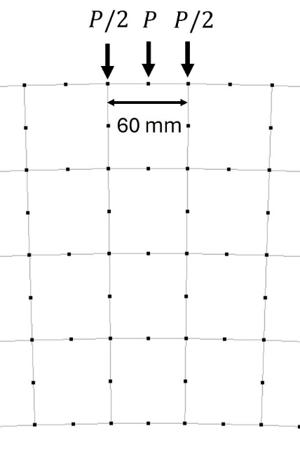
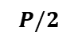
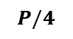
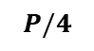
Loading pattern
Background
Methodology
Numerical modelling
Conclusions
Loading pattern
Loading was imposed through a plywood plate in the experiment (Load controlled)
Loading pattern in the numerical model
Load controlled
Displacement controlled
$$P/4$$
$$P/2$$
$$P/4$$
Load controlled
Displacement controlled

Slide 12

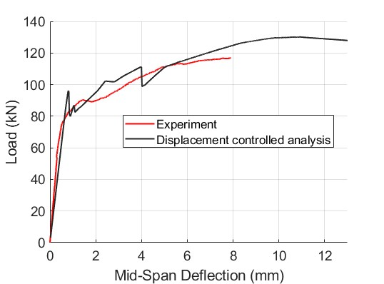
Modelling - Nonlinear analysis
Background
Methodology
Numerical modelling
Conclusions
Nonlinear analysis
Displacement controlled
Load controlled with arc length
Equal displacement is prescribed over the three nodes

Slide 13
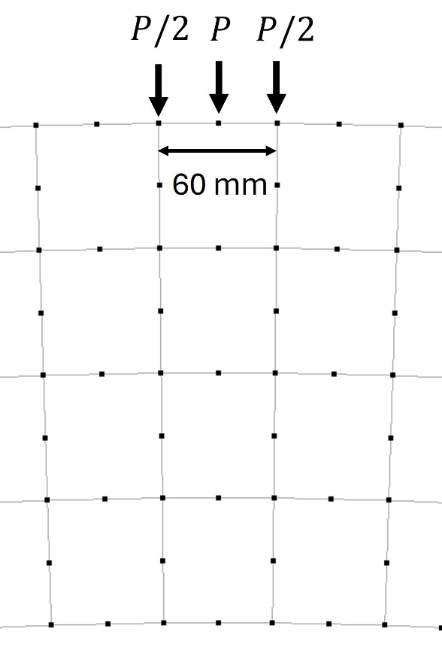
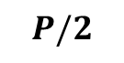
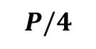
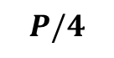
Modelling - Nonlinear analysis
Background
Methodology
Numerical modelling
Conclusions
Nonlinear analysis
$$P/4$$
$$P/2$$
$$P/4$$
Displacement controlled
Analysis 1 load-controlled
Load controlled with arc length method
Analysis 2 with arc length
Vertical displacements of the nodes are controlled by using adaptive load factor

Slide 14
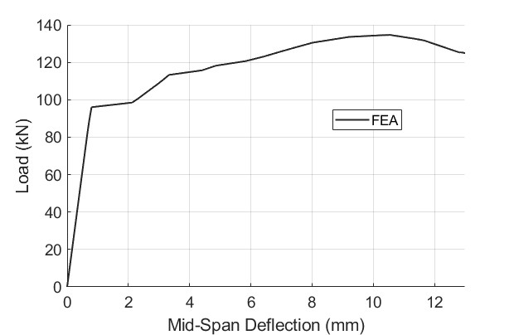
Modelling - Nonlinear analysis
Background
Methodology
Numerical modelling
Conclusions
Load controlled
(analysis 1)
Arc length (analysis 2)
Regular newton Raphson is used as iterative method.

Slide 15

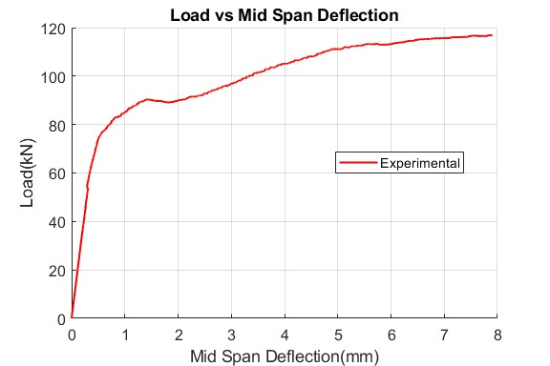
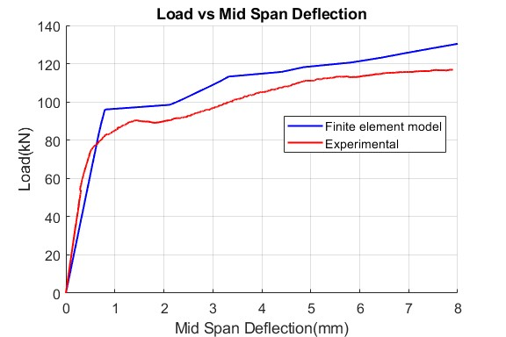
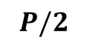
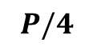
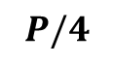
Modelling - Results
Background
Methodology
Numerical modelling
Conclusions
$$P/4$$
$$P/2$$
$$P/4$$
This nodal deflection corresponds to the reading of L1, L2, L3

Slide 16
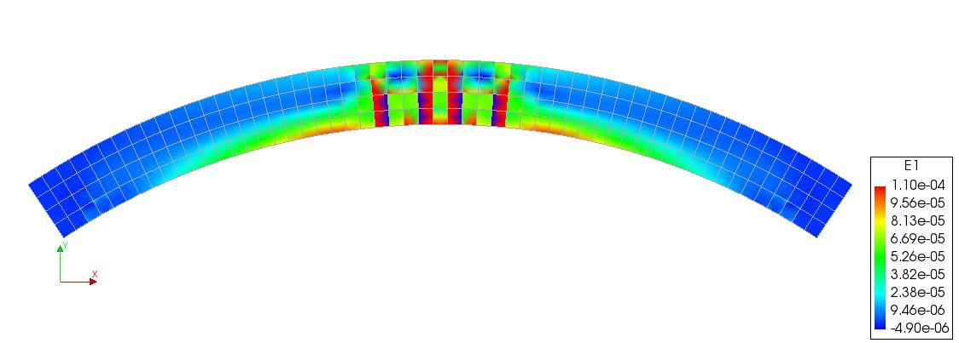
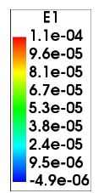
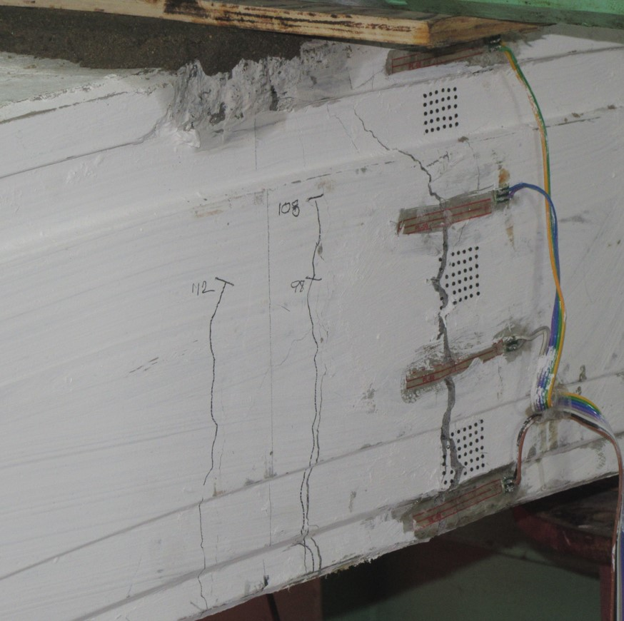
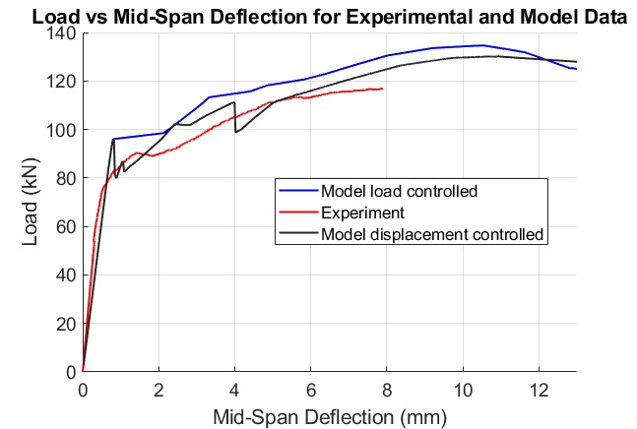
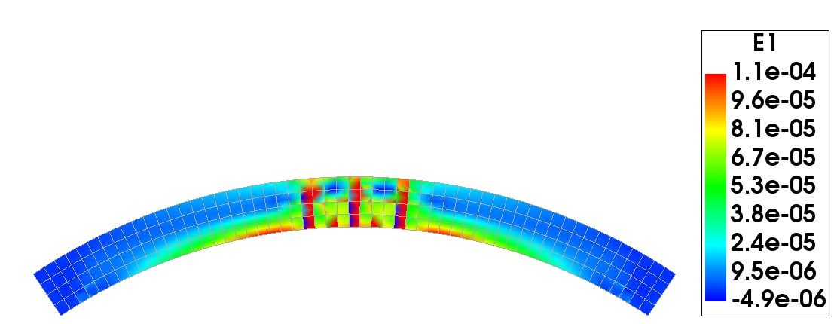
Load controlled vs displacement controlled
Background
Methodology
Numerical modelling
Conclusions
Load vs Displacement controlled analysis
Displacement control
Strain is more localized in the neighbouring elements than the middle elements.
Middle crack in the experiment
Load control
Strain is more localized in the middle elements
Load controlled analysis along with arc length method is adopted

Slide 17
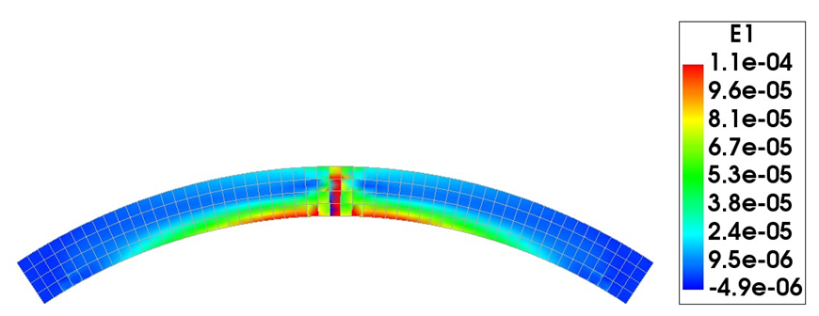
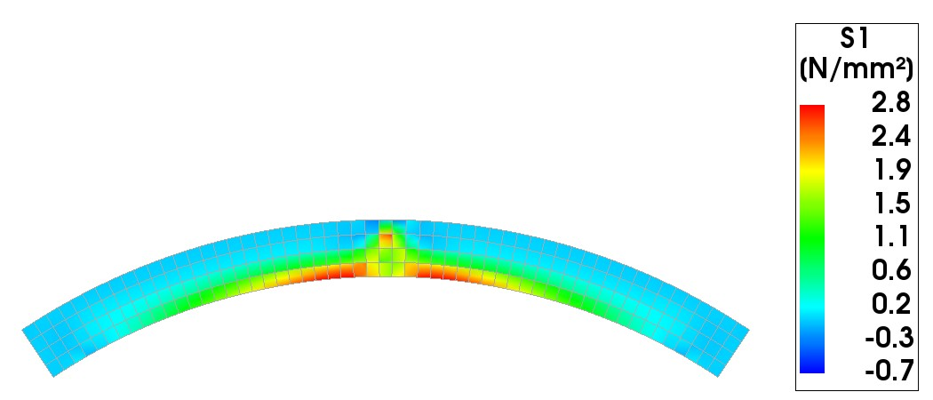
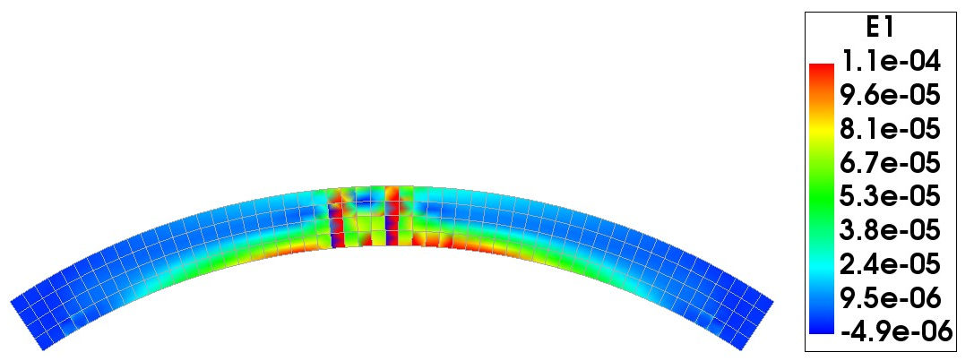
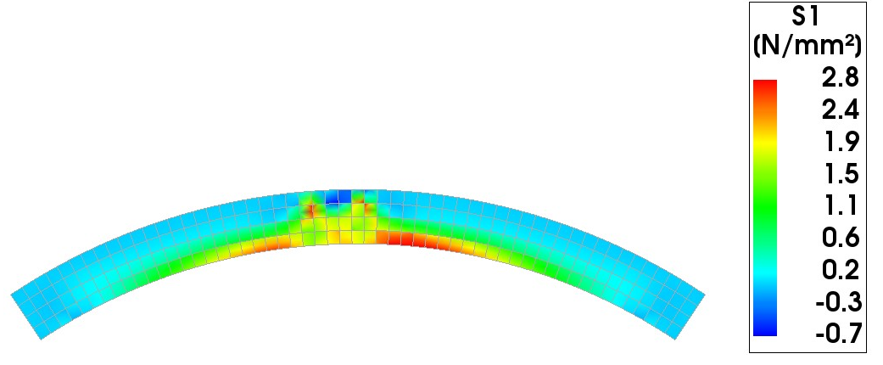
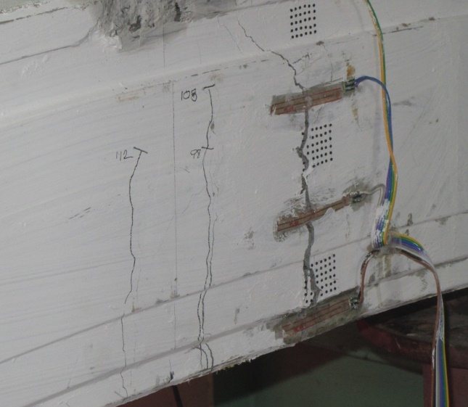
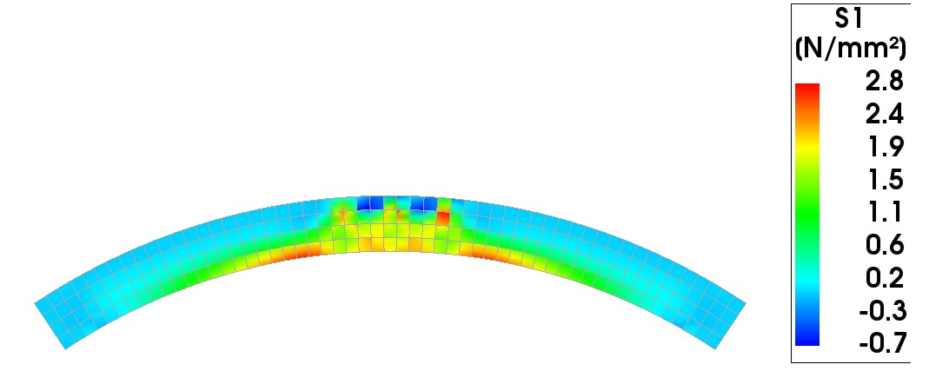
Modelling – Stress, Strain contours
Background
Methodology
Numerical modelling
Conclusions
Principal strain contour at A
Principal stress contour at A
B
C
A
Principal stress contour at B
Principal strain contour at B
Principal strain contour at C
Principal stress contour at C

Slide 18

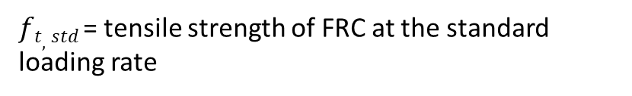
Modelling – Rate effect
Background
Methodology
Numerical modelling
Conclusions
Purpose:
How can we incorporate effect of loading rate in the numerical model?
Notched beam test with standard CMOD rate
Tensile constitutive law from inverse analysis
Modify the constitutive law for different CMOD rates
Input for tunnel model
$$CMOD=1.2CTOD$$
$ft,x$ = tensile strength of concrete at the CTOD rate
$ft,std$= tensile strength of FRC at the standard loading rate
$$ft,x=ft,std +m\log_{10} ({CTOD}_{x} )$$
𝜎_{𝑖,𝑥} is the different bridging stresses at the CTOD rate
$σi,x − σi,std = ft,conc,x − ft,conc,std + c\log_{10} ( {CTOD}_{x} )$
𝑓_{𝑡,𝑐𝑜𝑛𝑐,𝑠𝑡𝑑} is the tensile strength of plain concrete at the standard CMOD rate
Stephen et al.(2019)

Slide 19
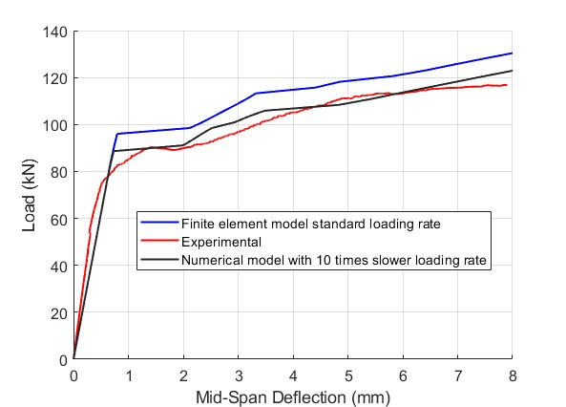
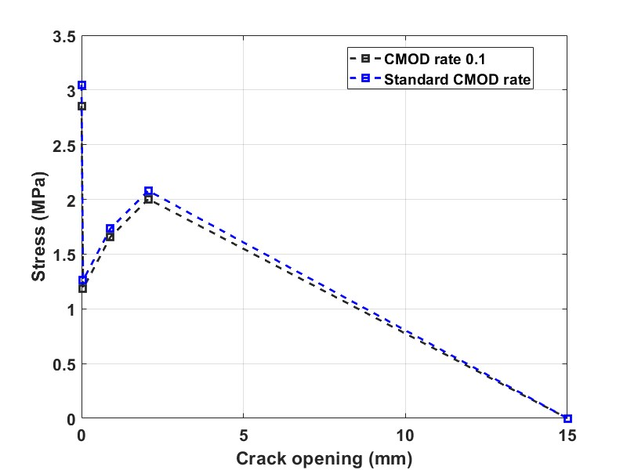
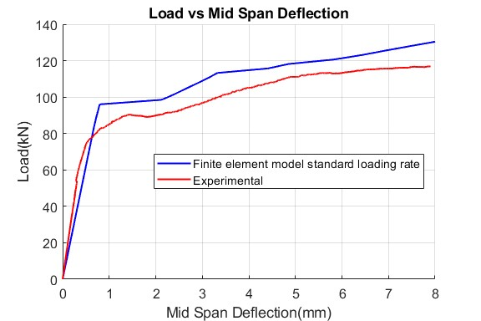
Modelling – Rate effect
Background
Methodology
Numerical modelling
Conclusions
Experimental loading rate = 0.2 kN/s
Modification of constitutive law
FEA with slower loading rate has a very good match with the experiment.

Slide 20
Conclusions
Background
Methodology
Numerical modelling
Conclusions
Load controlled analysis along with arc length can effectively capture the pre-peak as well as the post-peak zone
The numerical model could accurately predict the cracking pattern as well as the sequence of cracking.
By incorporating the tensile constitutive law corresponding to the slower loading rate, we could get good match with the experimental result.

Slide 21

THANK YOU

